Slide 1
Components of Database
Database system is partitioned into modules that deal with each of the responsibilities of the overall system.
The functional components of the database system are,
    Storage Manager
    Query Processor

Slide 2
Storage Manager
It is a component of database system that provides the interface between the low-level data stored in the database and the application programs and queries submitted to the system.
Storage manager translates the narrow DML statements into low-level file system commands.
It is responsibility for the interaction with file manager.
Thus, the storage manager is responsible for storing, retrieving and updating data is the database.
Components of storage manager are,
  Authentication & Integrity Manager
  File Manager
  Buffer Manager
  Transaction Manager

Slide 3
Authorization & Integrity Manager
Tests for satisfaction of integrity constraints and checks the authority of users to access data
Transaction Manager
It ensures that database remains in a consistent state despite system failure and the concurrent transaction executions proceed without conflicting.
File Manager
It manages the allocation of space on disk storage and the data structures used to represent information stored on disk.
Buffer Manager
It is responsibility for fetching data from disk storage to main memory & deciding what data to cache in main memory.

Slide 4
The storage manager implements several data structure such as,
  Data files
  Stores the database itself.
  Data dictionary
  Stores the metadata about the structure of the database(i.e) Schema of the database
  Indices
  It provides fast access to data items, The Database provides pointes to those data items that hold a particular index value

Slide 5
Query processor
It helps the database system to simplify and facilitate access to data components of query processor are,
DDL Interpreter
Interprets DDL statements and records the definitions in data dictionary.
DML Compiler
Translates DML statements into an evaluation plan consisting of low-level instruction that the query evaluation engine understands.
It also performs query optimization (i.e) it picks the lowest cost evaluation plan from among the alternates

Slide 6
Query Evaluation Engine
Executes low-level instructions generated by the DML compiler
Database systems can be centralized as client –server.
Based on this database applications are portioned into
    Two Tier architecture
    Three tier architecture

Slide 7
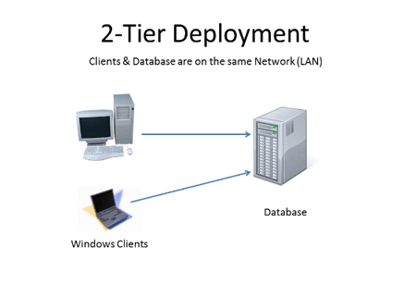
Two-tier architecture
Application resides at the client machine where it invokes database system functionality at the server machine through query language statements
E.g. client programs using ODBC/JDBC to communicate with a database

Slide 8
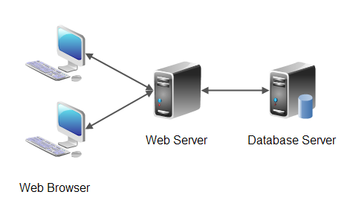
Three-tier architecture
Client machine acts as merely a front end and does not contain any direct database calls.
The client end communicates with an application server through forms interface and the application server in turn communicate with the database system to access data
E.g. web-based applications, and applications built using “middleware”

Slide 9
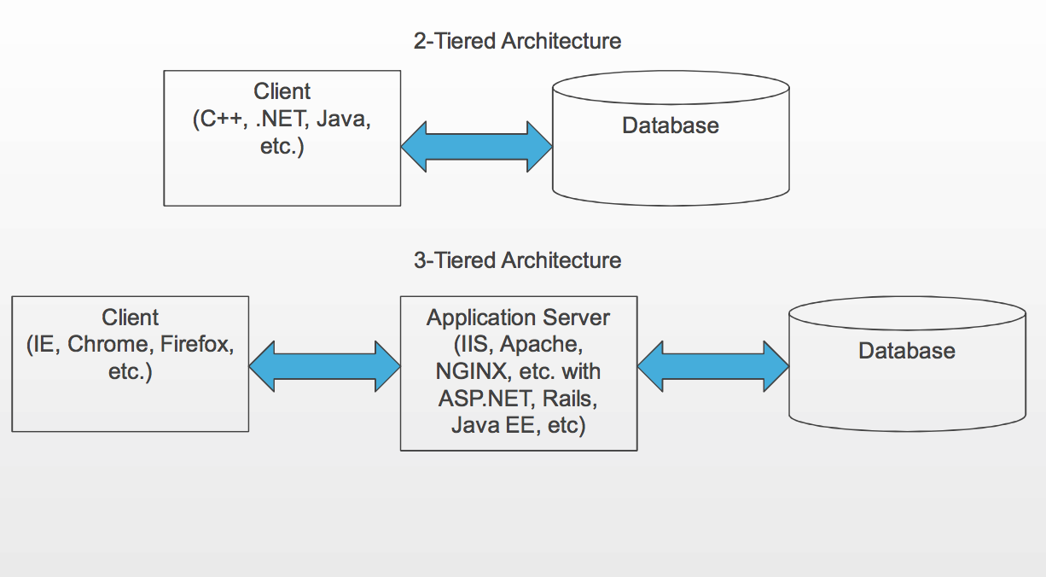

Slide 10
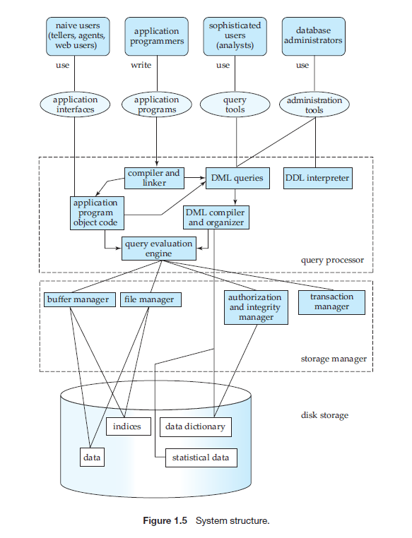

Slide 11
